Slide 2
A joint universal access point for couples in South Africa
Dr Natasha Davies
Wits Reproductive Health and HIV Institute
“Sticky Linkage”: Latest evidence and strategies satellite
Sunday, 21 July

Slide 3
Universal access points for women and men
Women
& Men
Women
Men
Antenatal care (ANC)
Family Planning (FP)
Safer conception
Voluntary medical male circumcision (VMMC)
Post-natal care
Expanded programme on immunization (EPI)
HIV
services
Men have limited universal access points that actively support HIV testing
Safer conception services: support HIV-affected individuals/couples to minimise horizontal and vertical peri-conception HIV transmission risks
Notes:
Health facilities rarely male-friendly
Clinical hours
Female > male providers
Female/child dominated spaces

Slide 4
Safer conception service project
Duration: June 2015 – April 2017
Site: Public sector, primary healthcare clinic, inner-city Johannesburg, South Africa
Model: Nurse-driven, sexual and reproductive health (SRH)/HIV integrated service
Clients: All HIV-affected individuals or couples desiring a safe pregnancy with minimal horizontal and vertical HIV risks
Notes:
Individuals in an HIV seroconcordant, HIV serodifferent or HIV serounknown (where one partner status was unknown) relationship were welcome to attend on their own or with their partner

Slide 5
Project goals
Differentiated service delivery model
Demonstration project
Provide male friendly space
SRH/HIV integration focus
Minimize vertical transmissions
Explore male partner uptake
Minimize horizontal transmissions
Notes:
NOTE: only speak to the highlighted red diamonds that speak to the ‘male aspects’ of the service to keep to time.
Demonstration project = proof of concept
Test differentiated care model for individuals and couples seeking to achieve their reproductive goals within the context of potential HIV risk
To explore whether the availability of such a service may influence the uptake of HIV services by male partners
Would a focus on a ‘health’ service (building a family), as opposed to an ‘illness focused service appeal to men and draw them into care?
To provide a male friendly ‘safe space’ where men would feel comfortable accessing integrated SRH and HIV services
To observe whether a safer conception service would minimise horizontal and vertical HIV transmissions risks

Slide 6
Safer conception service components
Safer Conception Toolbox
STI screening and Rx
Timed Condomless Sex
Self-insemination
Encourage disclosure and partner testing / treatment
VMMC
Pre-exposure Prophylaxis
ART with viral suppression
HIV testing
General preconception health
Cervical cancer screening
Early antenatal referral
Notes:
HIV counselling and testing for those previously tested negative or with unknown HIV status
Disclosure support for known positive clients who had not yet disclosed to their ‘pregnancy partner’
ART initiation for known positives not yet on ART or newly diagnosed individuals
ART optimisation, including adherence support, for those already on ART but not virally suppressed < 200 copies
Regular viral load monitoring including viral load at entry to service
STI screening and syndromic management, including hepatitis B and syphilis blood monitoring
Cervical cancer screening for all females according to South African guidelines
Male partner referral for voluntary medical male circumcision if requested by male
HIV negative partners were offered PrEP
Safer conception methods counselling
Methods available included: timed condomless sex to peak fertility and manual self-insemination
Counselling also included information about U=U and the importance of sustained ART adherence and regular STI screening
Baseline screening for non-communicable diseases and any other conditions or lifestyle choices that may impact on general pre-conception health
The package of care did not include any assisted reproductive technologies to support couples with infertility

Slide 7
Enrolment among men
692 clients enrolled, 238 were men (34%)
Age (years) | N | %
18-24 | 4 | 1,7
25-34 | 90 | 37,8
35+ | 144 | 60,5
Total | 238 | 100

Slide 8
Couple vs individual participation
Individuals enrolled
(n=692)
Unaccompanied women
(n=224)
Initially attended service together
(n = 242)
Both partners engaged
(n=460)
One partner engaged
(n=232)
Initially unaccompanied
(n = 218)
Median time to second partner engagement: 39 days [IQR 14-112]
Unaccompanied men
(n=8)
462 dyads represented
Notes:
230 couples attended with both partners (460 individuals)
121 couples came together from the first visit
109 couples one partner joined on average 39 days after the presenting partner attended for their first visit (IQR 14-112 days)
232 individuals attended without their partner
8 men attended alone without their female partner
224 women attended without their male partner

Slide 9
HIV dynamics of dyads by end of intervention
Couples (n=230)
Unaccompanied individuals (n=232)
66 men remained with unknown HIV status:
29 undisclosed to
37 disclosed to but chose not to test
Male partners of unaccompanied women were less likely to test or share their
HIV status
Notes:
Couples (n= 230)
57% seroconcordant
25% serodifferent with an HIV negative male partner
17% serodifferent with an HIV negative female partner
1 male partner continued to attend but never agreed to test
Unaccompanied individuals (n= 232) (based on report of present partner)
40% seroconcordant
25% male negative serodifferent
2% female negative serodifferent
33% sero-unknown (the unengaged partner status remained unknown)

Slide 10
Male testing and linkage outcomes
53% of men who were eligible accessed HIV testing (75/141)
20% yield (15/75)
93% initiated ART (14/15)
77% of known positives not yet on ART initiated at the clinic (24/31)
3 declined ART
3 were ineligible (high CD4 before treat all policy)
1 died in hospital at time of diagnosis
Notes:
15 new diagnosis
11 tested positive after enrolling at SCS
4 tested at other facilities following encouragement from enrolled femaleClients were initiated within 14 days, once baseline bloods were available,
Integrated service
There’s no point in finding the positive men and not providing an integrated services that links to initiation without additional steps being involved
Treatment literacy and adherence counselling was provided by a male lay counsellor and reinforced by the nurse clinicians

Slide 11
SRH needs for enrolled men
54% reported ≥ 1 condomless sex act within past 30 days at baseline
40% reported ≥ 1 previous STI
18% needed syndromic STI management during follow-up
7% had evidence of syphilis
RPR and/or TPHA positive
7% evidence of active hepatitis B infection
20% reported erectile dysfunction at baseline
Need for improved
male-friendly SRH services for men

Slide 12
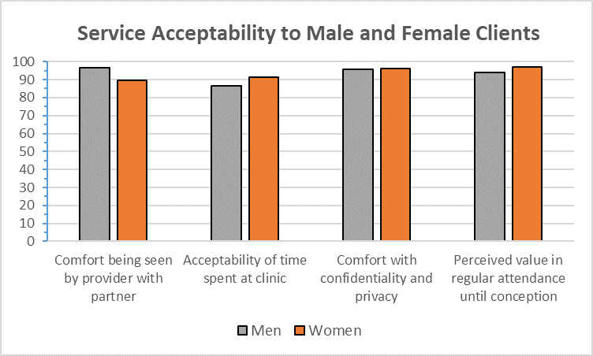
Service acceptability survey
High male acceptability, comfort and perceived value
Fig.1 Service acceptability among men and women attending safer conception care in Johannesburg, South Africa (2016-2017)
Ref: S Schwartz, N Davies et al, 2019 https://doi.org/10.1186/s12978-019-0718-5
Notes:
Knowledge of methods, self-efficacy to use methods and confidence in the service’s ability to achieve it’s goal of reduced risks of transmission was also high amongst the male clients surveyed.

Slide 13
Conclusion
Men are interested in their own, and their partners’, sexual and reproductive health and rights,
Opportunity for HIV/SRH integration to support male engagement in services
Safer conception services are a model
that attracts men, including those otherwise not engaged in traditional HIV testing, care and treatment services
that provide a unique opportunity to work with men and women in partnership to optimise both HIV and SRH outcomes
Notes:
Male focused/male friendly services remain scarce
Particularly for heterosexual men
Particularly in resource limited settings

Slide 14
Available: Free Online Resources
Safer conception implementation guide, clinical and monitoring and evaluation tools (Wits RHI)
http://bit.ly/2lnt9cM
Safer conception clinical guidelines
Southern African HIV Clinicians’ Society)
“Guidelines to support HIV-affected individuals and couples to achieve pregnancy safely: Update 2018”
https://sahivsoc.org/Files/guidelines%2018%20oct.pdf

Slide 15
ART coverage and viral suppression outcomes
“Must do better: Addressing the failures of SRH HIV integration”
Poster discussion: TUPDC01
Tuesday 23 July, 13:00 - 14:00
Casa del Diezmo 3 y 4

